Slide 1

Think-Positive A mental health assessment platform
Hack The Change Group - 14
Aleksander Berezowski, Kail Olson, Mohammed Alshoura, Kartik sharma, Kirtan Kakadiya

Slide 2

What’s the idea?
An assessment tool that allows users to gain insight about their mental health.
The program presents tips to deal with feelings of anxiety and depression.
A long-term progress tracking tool that focuses on steady mental health improvement.

Slide 3
Our implementation
Web app with a question bank based on scientific papers regarding anxiety and depression.
Suggests actions for the betterment of symptoms user responds most strongly to.

Slide 4
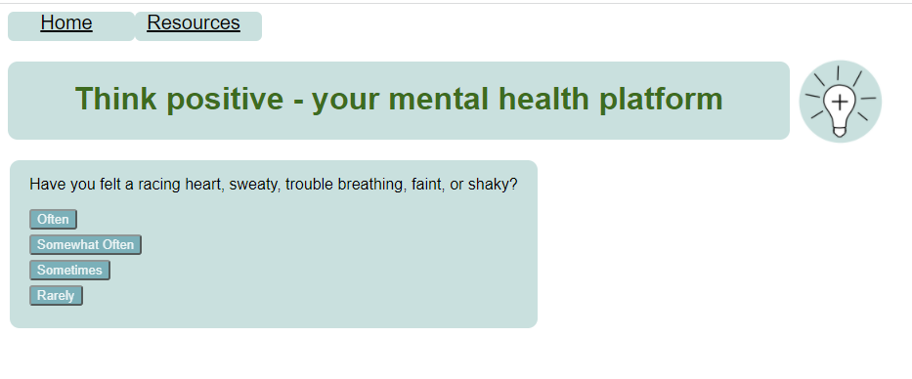

Slide 5
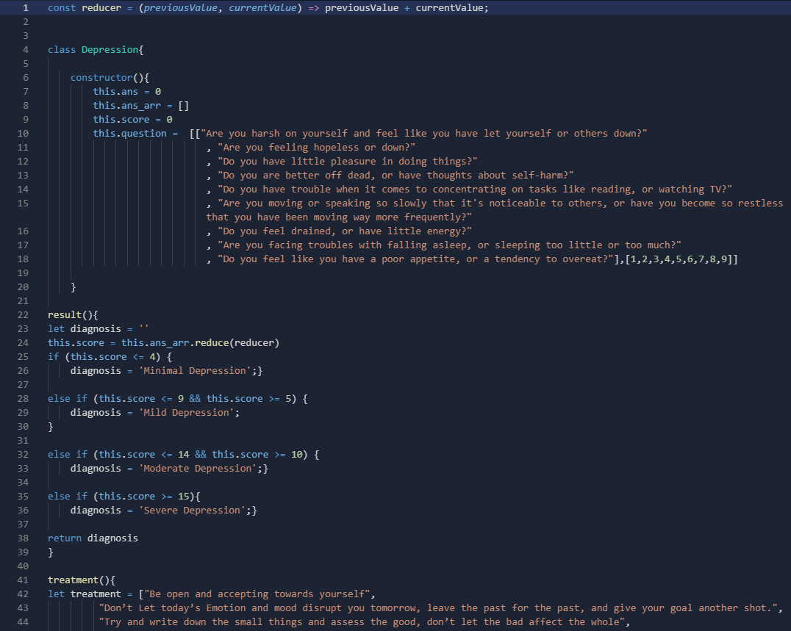

Slide 6
Technologies used
Weather forecast API*
NodeJS for hosting the site
Repl.it for integrated development
Web-server hosted database for questions*
Numpy and Matplotlib for data visualization*
Google forms integration*
Notes:
Weather forecast API
NodeJS for hosting the site
Repl.it
Web-server hosted database
Numpy Maplotlib data visualization

Slide 7
Summary and improvements
We were successfully able to make a “quiz” type web application.
We would like to fully integrate the technologies mentioned earlier in the future.
Possibly integrate ML for synthesizing user data to suggest more intelligent support for mental health.

